Slide 1
Insurance Premium Prediction Detailed Project Report
MD RIAN UR RAHAMAN

Slide 2
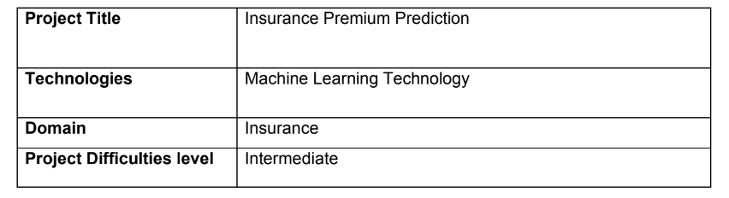
Project Overview Table

Slide 3
Description
This data science project focuses on developing a comprehensive solution to predict and mitigate customer churn in a subscription-based business model. The project follows a systematic end-to-end approach, encompassing data collection, preprocessing, exploratory data analysis (EDA), feature engineering, model selection, training, and deployment. The primary objective is to empower businesses with actionable insights to retain valuable customers and optimize revenue streams.Top of Form
The project begins with data collection from diverse sources, including customer interactions, transaction history, and demographic information. Data preprocessing involves cleaning, handling missing values, and transforming raw data into a format suitable for analysis. The EDA phase employs statistical and visual techniques to uncover patterns, correlations, and potential factors influencing customer churn.
Feature engineering is a crucial step, extracting meaningful insights from the data to enhance predictive model performance. Various machine learning algorithms, such as logistic regression, decision trees, and ensemble methods, are explored and evaluated for their ability to predict customer churn accurately. Model hyperparameter tuning and cross-validation techniques are applied to optimize the model's performance.

Slide 4
Problem Statement and Approach
Problem Statement:
The goal of this project is to give people an estimate of how much they need based on
their individual health situation. After that, customers can work with any health
insurance carrier and its plans and perks while keeping the projected cost from our
study in mind. This can assist a person in concentrating on the health side of an
insurance policy rather han the ineffective part.
Approach:
The classical machine learning tasks like Data Exploration, Data Cleaning,
Feature Engineering, Model Building and Model Testing. Try out different machine
learning algorithms that’s best fit for the above case.
Some Famous Algorithms: - Multiple Linear Regression, Decision tree Regression and
Gradient Boosting, Decision tree, Regression

Slide 5
About The Dataset
Data Collection:
3.1 Data Collection
The dataset was taken from Kaggle dataset ,available in this link : https://www.kaggle.com/datasets/noordeen/insurance-premium-prediction
3.2 Data Description
About Dataset
Context
The insurance.csv dataset contains 1338 observations (rows) and 7 features (columns). The dataset contains 4 numerical features (age, bmi, children and expenses) and 3 nominal features (sex, smoker and region) that were converted into factors with numerical value designated for each level.

Slide 6
Data Preprocessings
3.4 Data Preprocessings
To preprocess this dataset, which contains information about individuals' age, sex, BMI, number of children, smoking status, region, and medical expenses, several steps are necessary to prepare it for analysis or modeling. First, we'll handle any missing values to ensure the dataset's completeness, as missing data can impact model performance. Next, we'll convert categorical variables, such as 'sex', 'smoker', and 'region', into numerical formats using techniques like one-hot encoding. This step is crucial for algorithms that require numerical input. For instance, 'sex' will be transformed into binary variables, while 'region' and 'smoker' can be encoded into separate columns.
We will also normalize or standardize the numerical features, such as 'age', 'BMI', and 'expenses', to ensure they are on a similar scale, which can improve the performance of many machine learning algorithms. Additionally, the 'children' column, which contains count data, will be left as is since it is already numerical. After these transformations, we will split

Slide 7
Model Training
3.5 Model Training :
The provided code snippet demonstrates the process of training and selecting the best model for predicting insurance premiums. The code begins by importing essential libraries, including various regression models from sklearn, custom exception handling, logging functionalities, and utility functions for saving objects and evaluating models. The ModelTrainerConfig dataclass is used to specify the file path for saving the trained model. The ModelTrainer class is then defined, initializing the configuration and providing the initiate_model_training method.
In the initiate_model_training method, the training and testing datasets are split into dependent (y) and independent (X) variables. A dictionary of regression models is created, including LinearRegression, DecisionTreeRegressor, RandomForestRegressor, AdaBoostRegressor, SGDRegressor, Lasso, ElasticNet, SVR, and Ridge. The evaluate_model function is then called to evaluate each model's performance on the training and testing data, and the results are logged and printed.
The method identifies the best-performing model based on the highest R2 score from the evaluation report. The name and score of the best model are logged and printed, highlighting the best model found. Finally, the best model is saved to the specified file path using the save_object utility function. Exception handling ensures that any errors during model training are logged, and a custom exception is raised. This structured approach ensures robust model training and selection, facilitating effective prediction of insurance premiums.

Slide 8
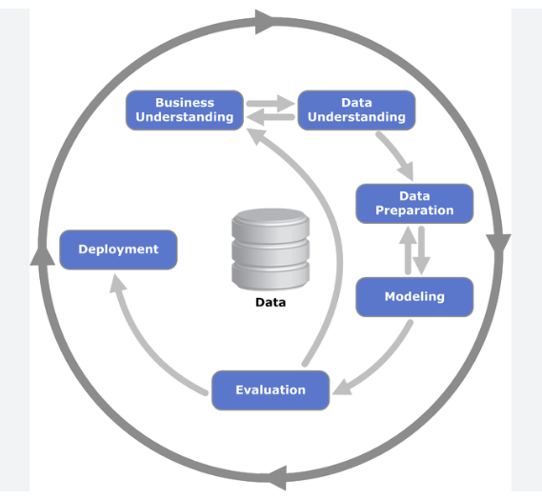
Architeture Diagram

Slide 9
Result and Accuracy
Mean Absolute Error : 52.13
Mean Squared Error :4621.193128091531
Root Mean Square : 85.06
The Model was ready and it was saved using pickle library.
We can download artifacts , preprocessor model etc.
Accuracy : 92%

Slide 10
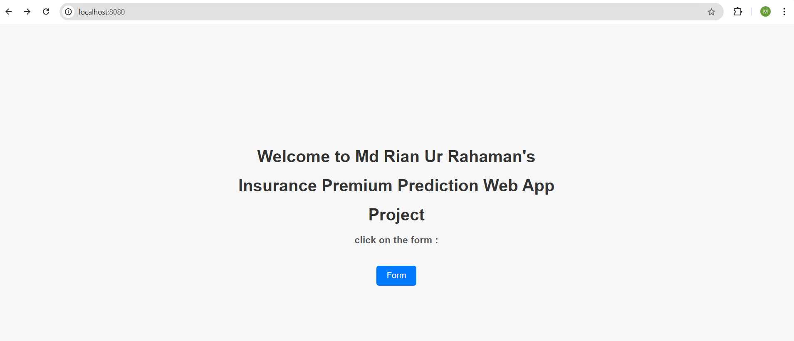
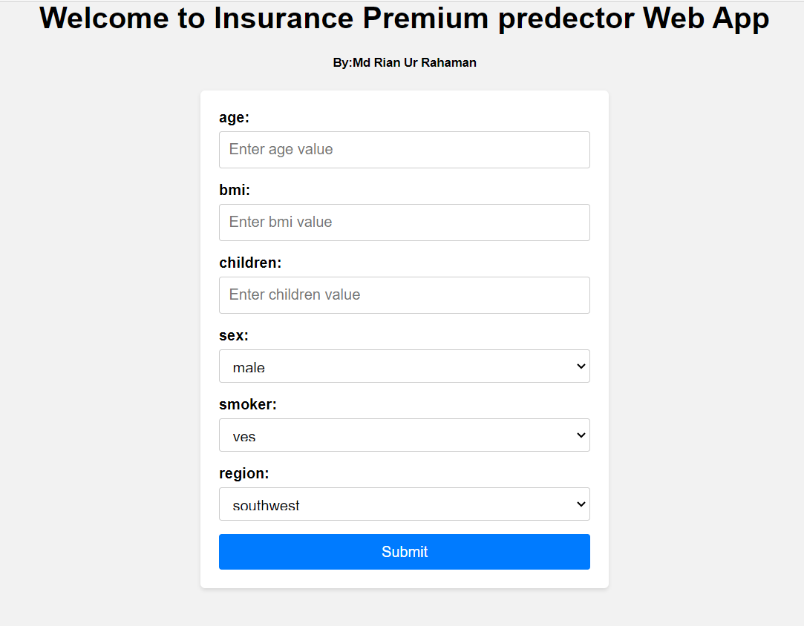
Web App Using Flask ,HTML and CSS

Slide 11
Conclusion
Out of the 6 models tried, AdaBoostRegressor() model yielded best prediction accuracy of 92% on Test Data.
I have successfully built an end-to-end web application using machine learning that can help predict the total count of bikes rented by the users based on various conditions.
This type of system can help users to get a better understanding the value of INSURANCE the day is good for riding bikes and make their decision making easier.

Slide 12
The End
THANK YOU
MD RIAN UR RAHAMAN
Mail ID : mdrianurrahaman@gmail.com
Source Code on Github : https://github.com/mdrianurrahaman/Insurence
Linkdin : https://www.linkedin.com/in/mdrianurrahaman/

